Slide 1
Sherwood Pedestrian
Bridge Medallion Art

Slide 2
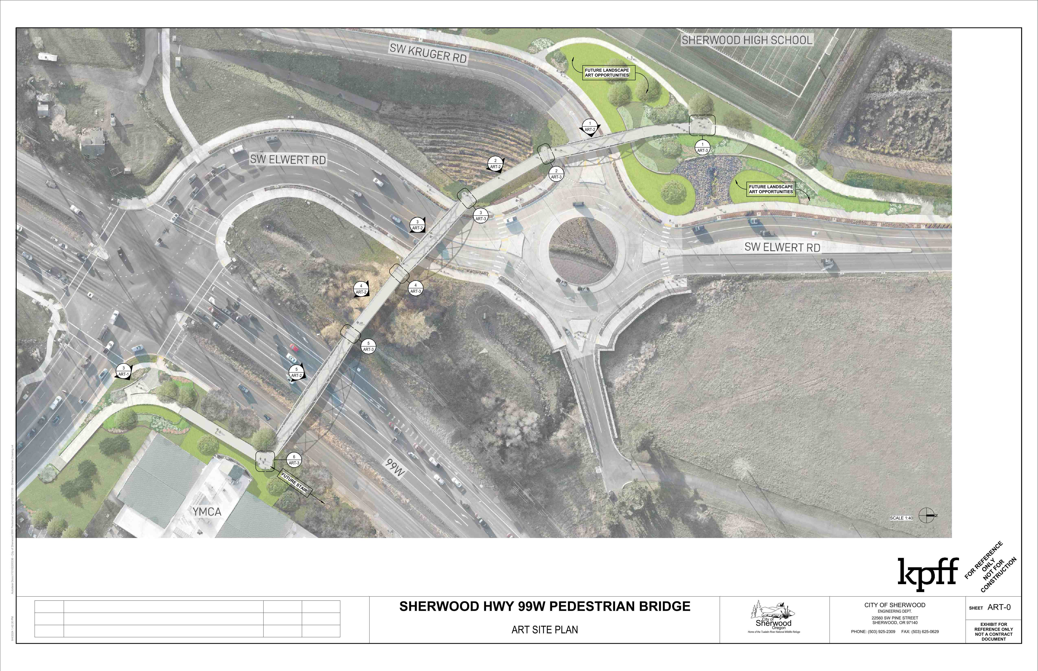

Slide 3
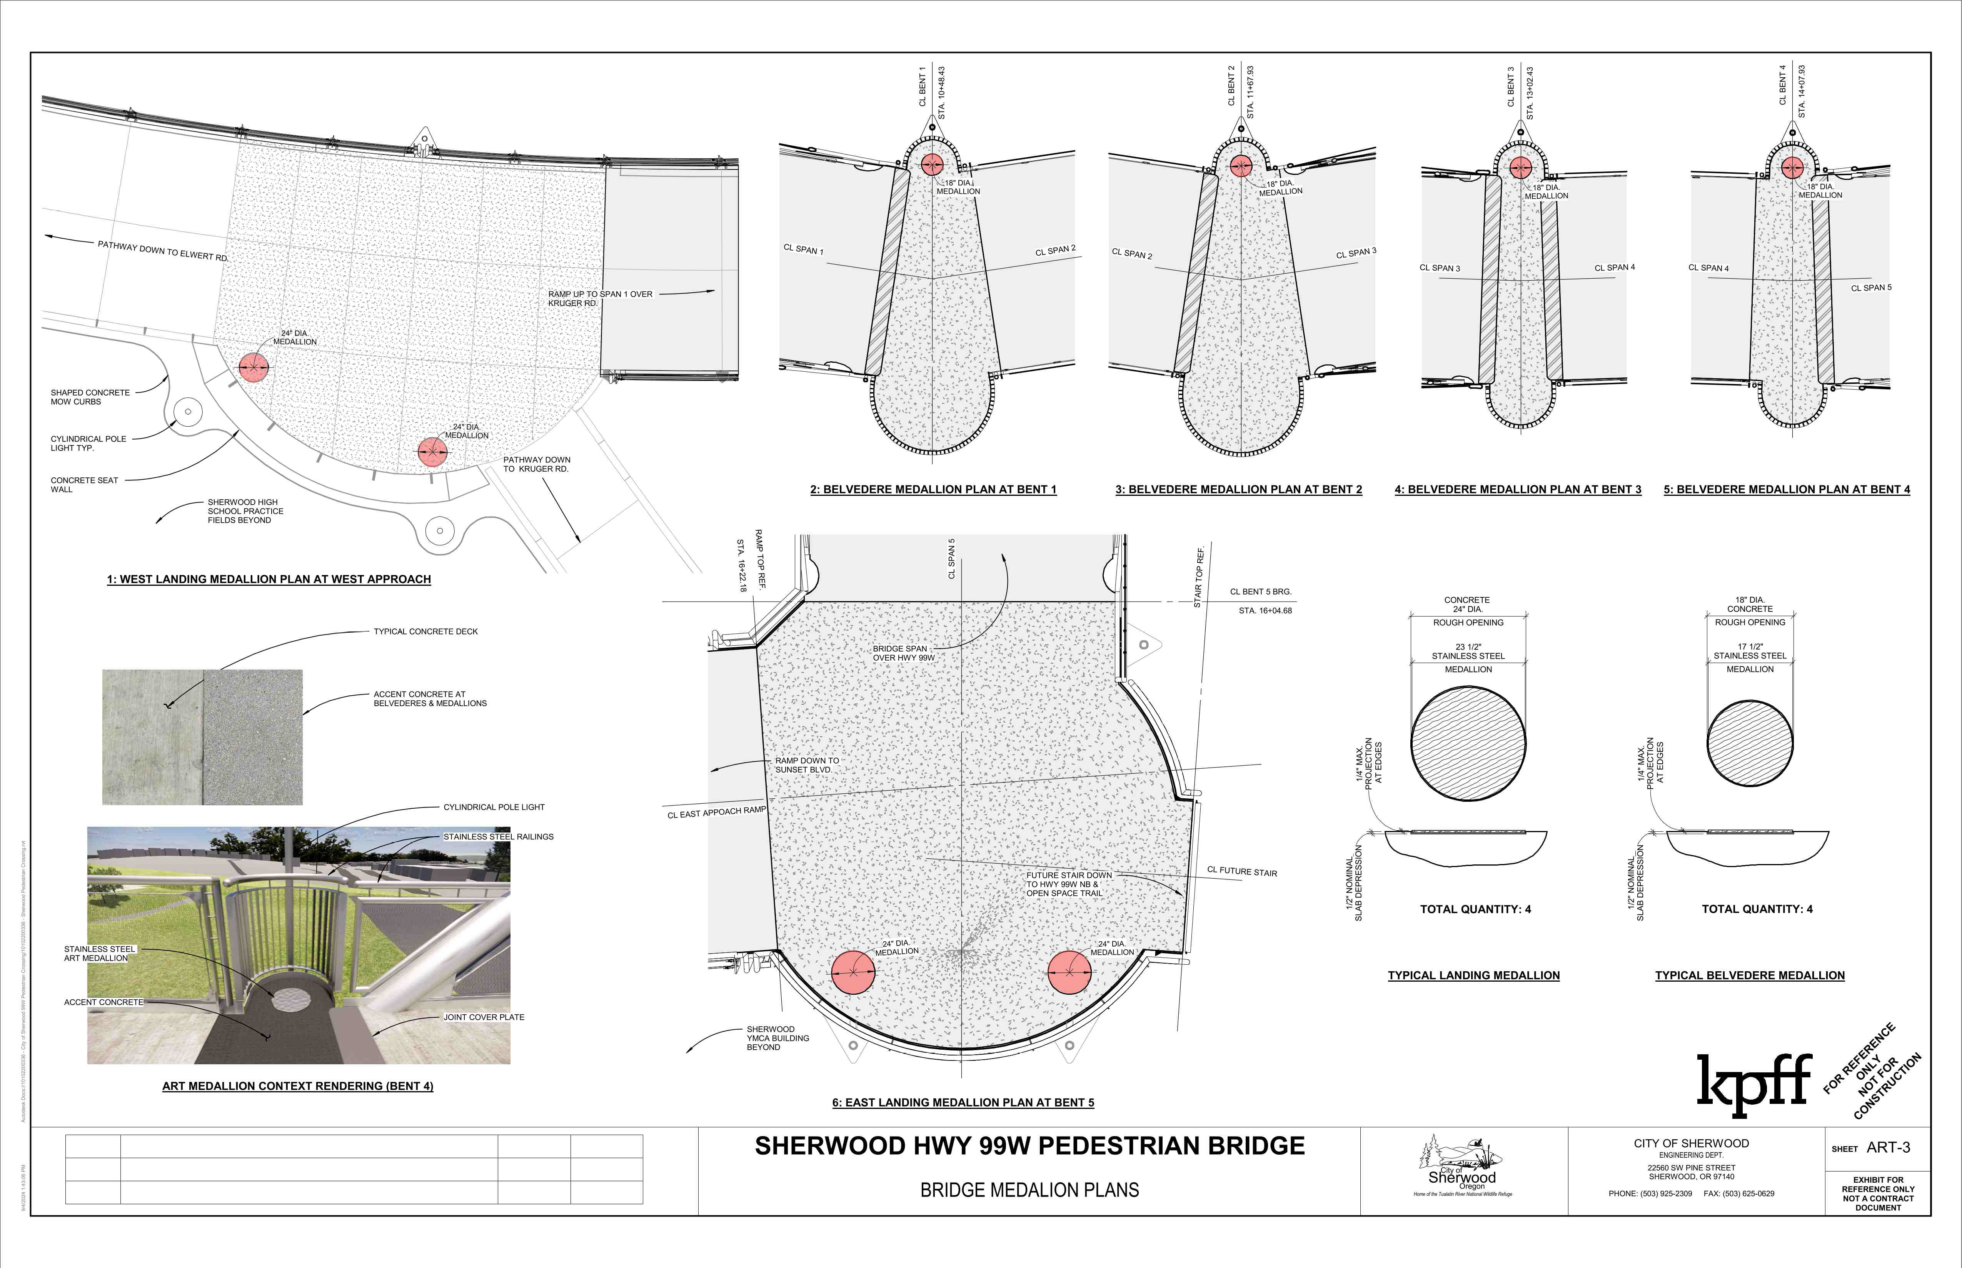

Slide 4
The Cultural Arts Commission aims to provide art that engages the public as they walk this long pedestrian bridge.
Focus groups’ top interests:
Something family-friendly
Something that emphasizes Sherwood’s natural setting and wildlife
Something that honors the history of this area

Slide 5
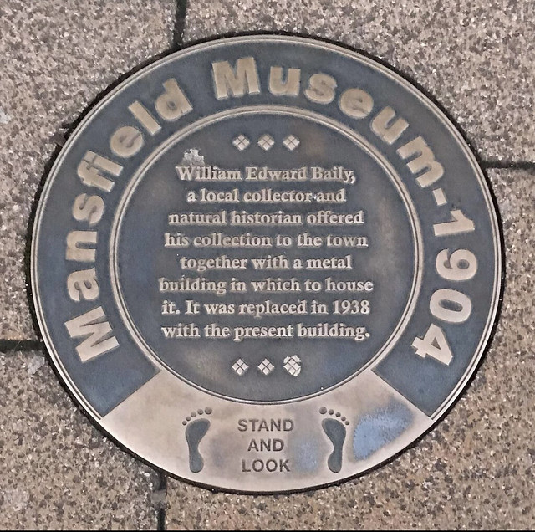
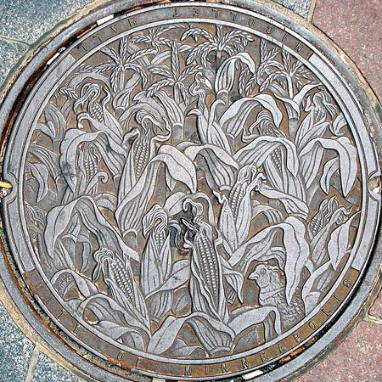
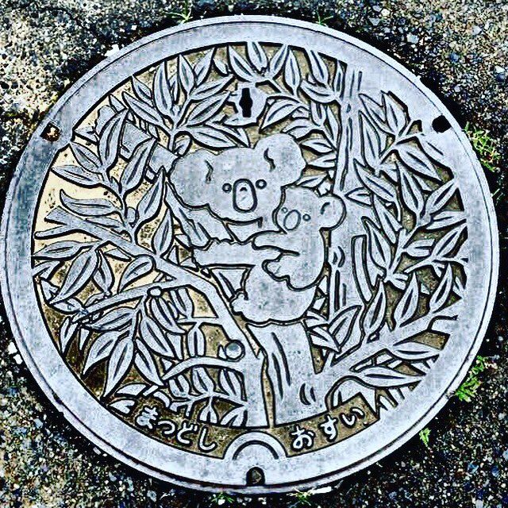
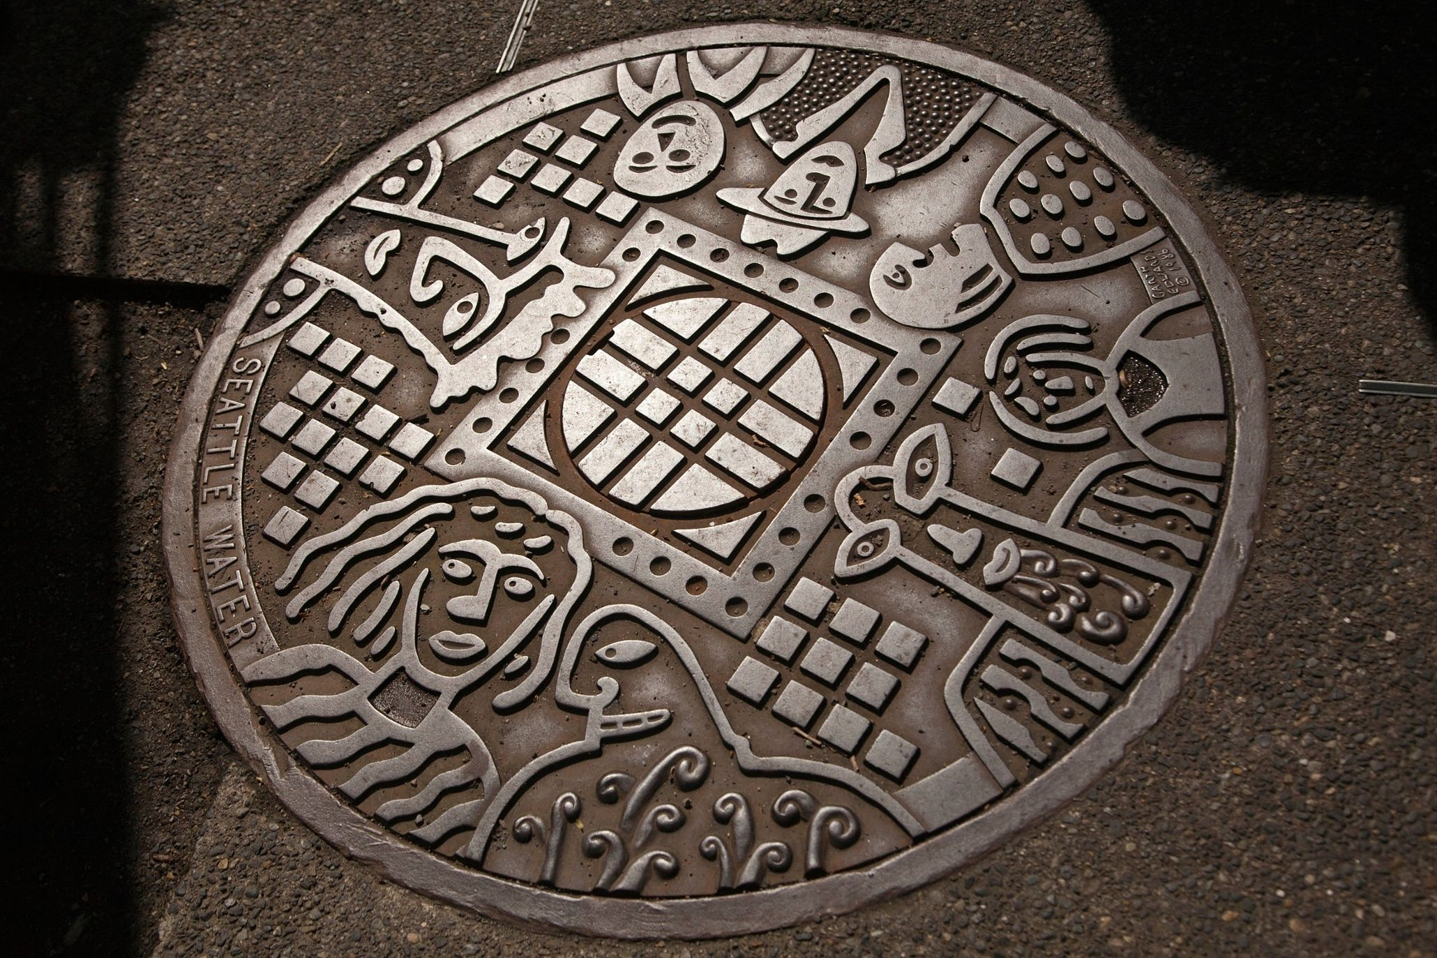
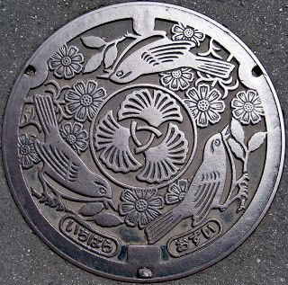
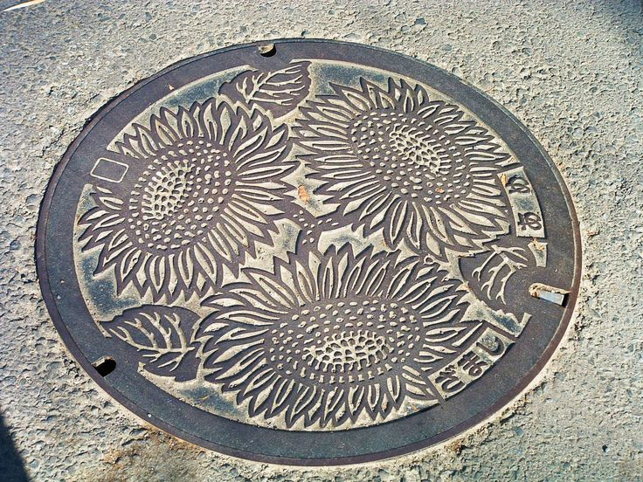
Medallion Examples

Slide 6
Theme:
Who Walked Here?
A pedestrian bridge offers us the opportunity to engage walkers with their environment. Think of each belvedere as a chance to step into a different time—as the medallion asks pedestrians to imagine who walked here before them, and what they might have seen as they look out.
Historically, what animals and people groups have traveled this way? Who has called this area home? In whose footsteps might we be traveling?
We want to create a “stop and look” moment.

Slide 7
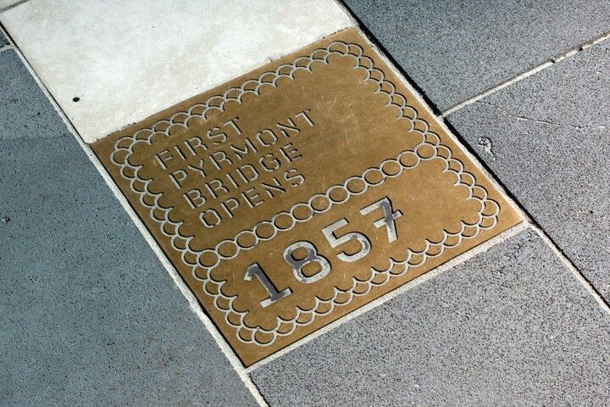
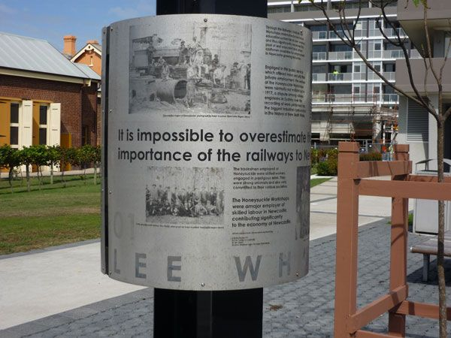
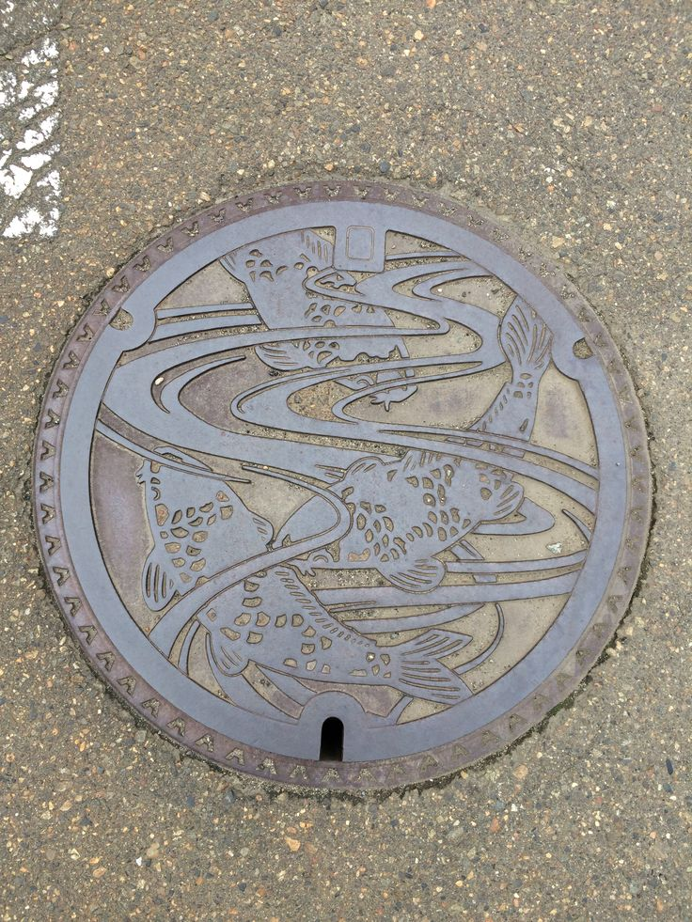
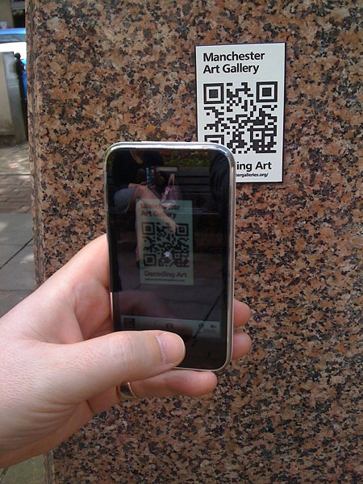
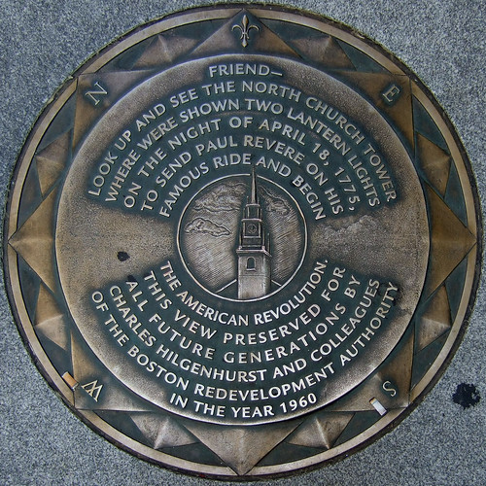
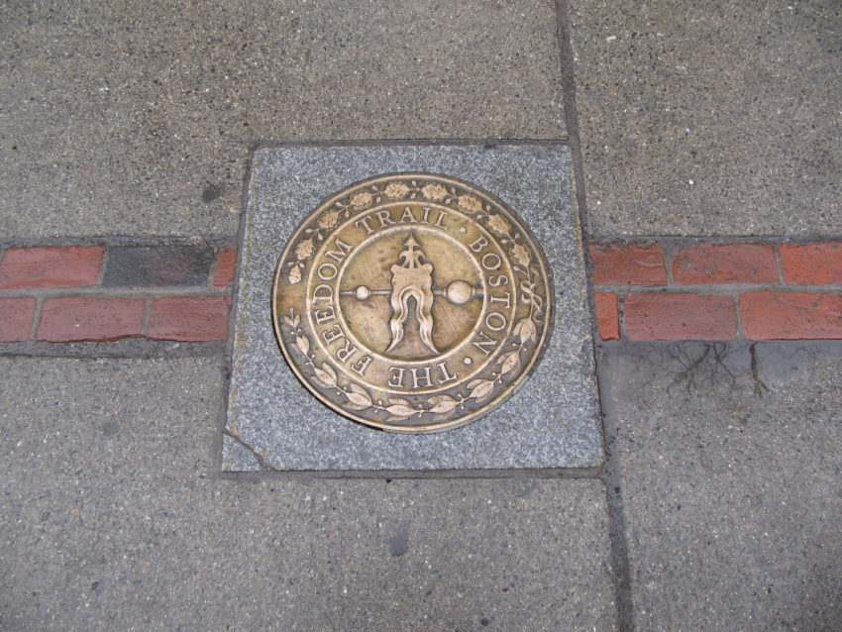
More examples of metal art as placemaking

Slide 8
Next step:
Put out a call for artists to see who has the vision to create a medallion trail that is artistically sound; and also encourages participation, creates a memorable experience, and fosters discovery.
The Goal: bridge the gap between pedestrians and their environment, and building in digital access as well—encouraging present-day walkers to see themselves in the story.

